Slide 1
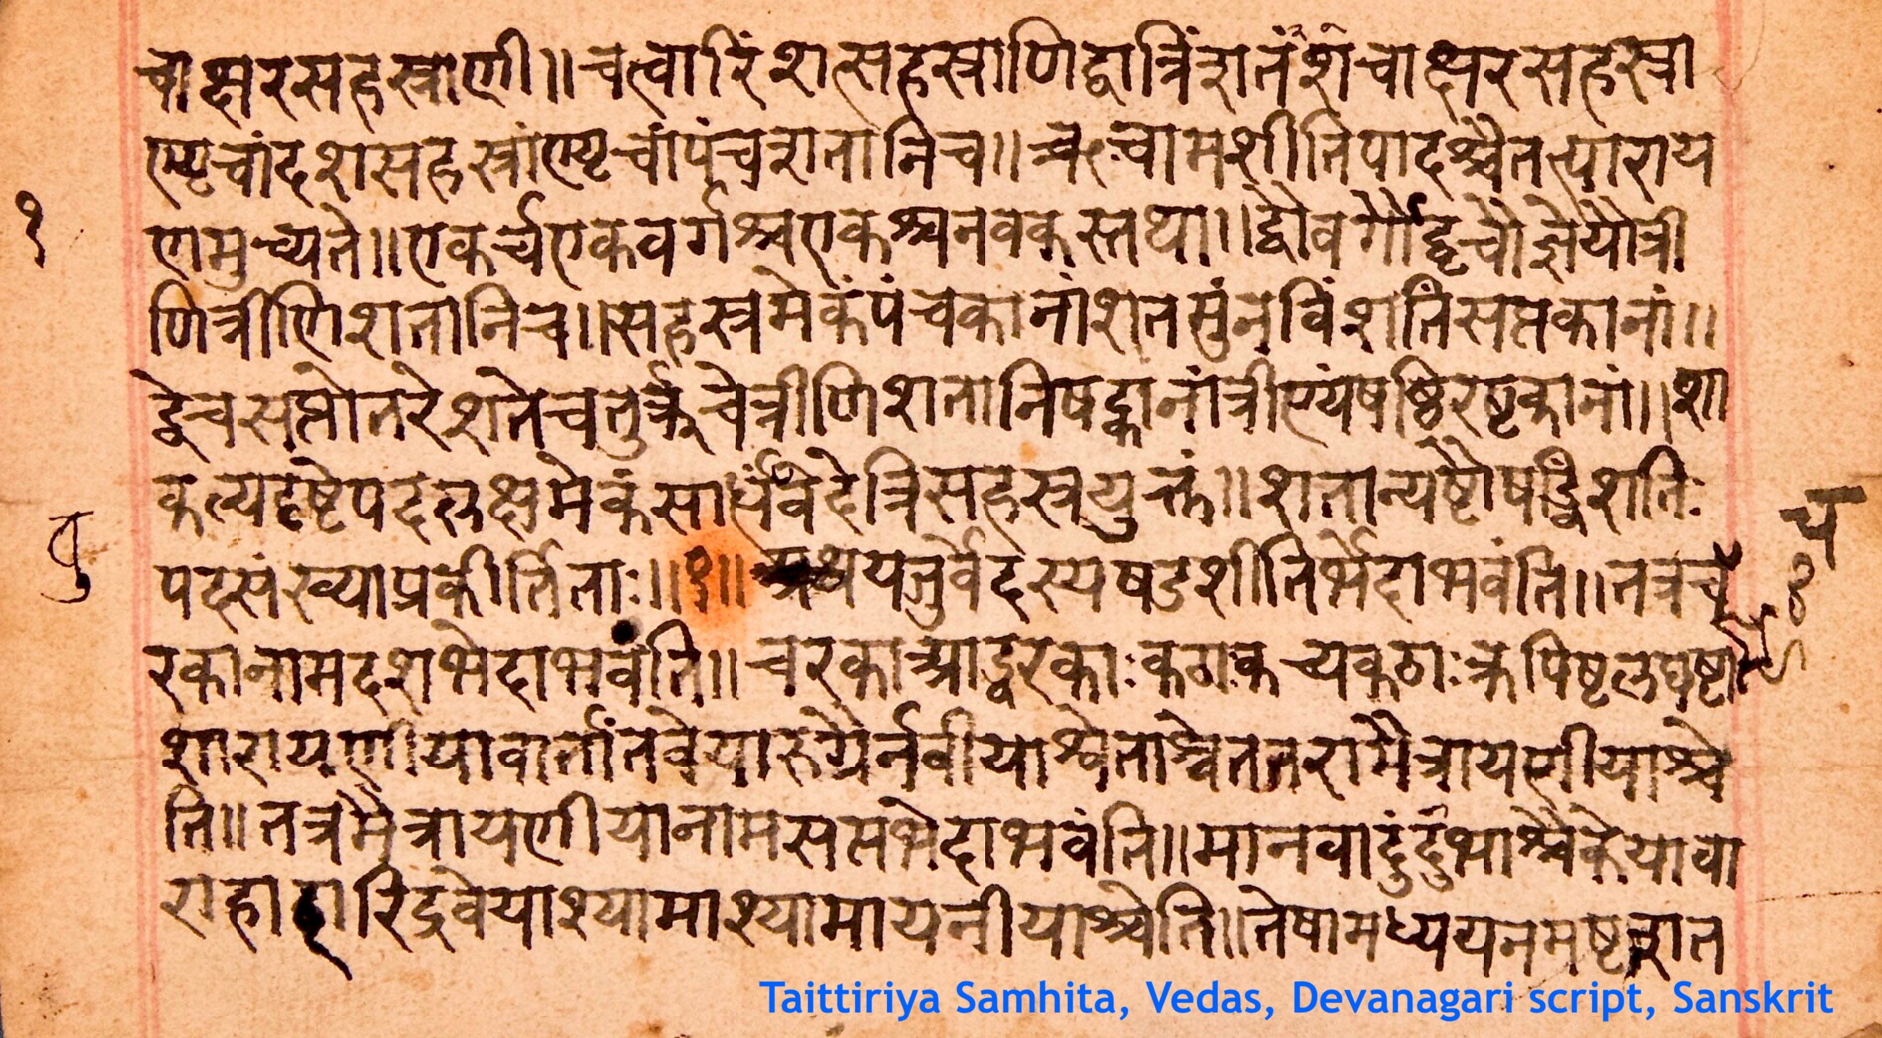
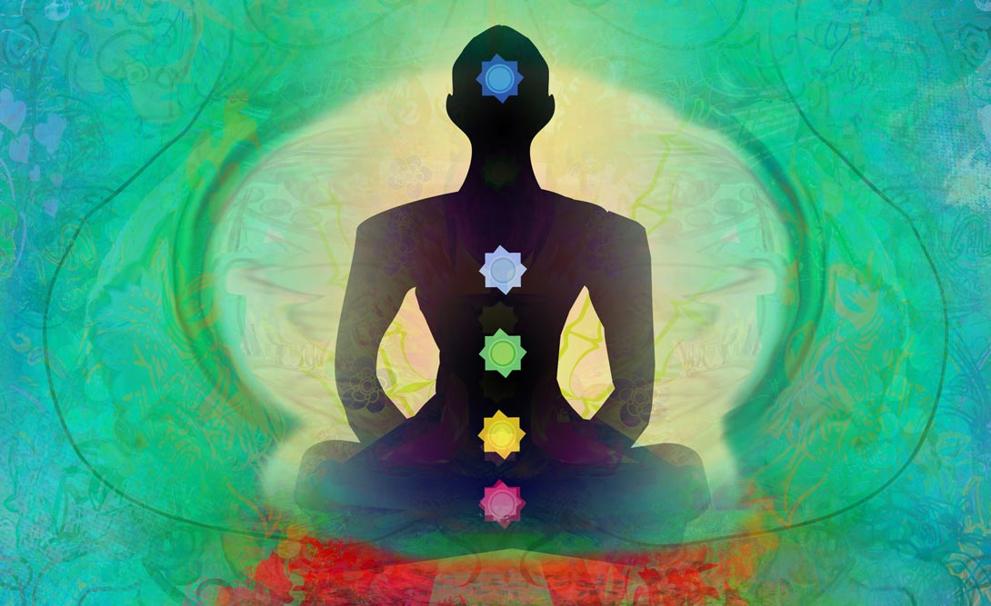
The Vedas: An Overview
TEAM - 10
TEAM 10
KRITHIKA S
PVR. MURTHY
BACHU GANESH
PRIYADHARSHINI AR
CHEREDDY SPANDANA

Slide 2
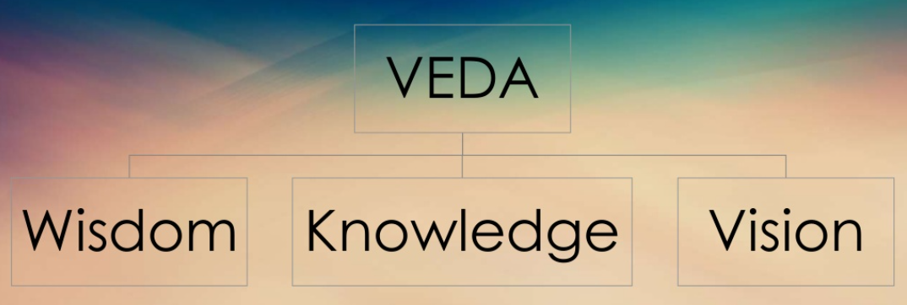
Origin of Vedas
The Vedas are a collection of hymns another religious texts composed in India between about 1500 and 1000 BCE. It includes elements such as liturgical material as well as mythological accounts, poems, prayers, and formulas considered to be sacred by the Vedic religion.
The Vedas as the records point out to be originated in the Indian Sub-continent and its written form origin dates back to 1600 BCE.

Slide 3
Introduction to Vedas
Veda simply means “Knowledge”. It is a Sanskrit word from the root “Vid”, which means finding, knowing, acquiring, or understanding. What you acquire or understand is knowledge. The term Veda as a common noun means “knowledge”.
The ideas, teachings, and practices described in the Vedas formed the basis for the six major schools of Hindu philosophy – Nyaya, Vaisheshika, Samkhya, Yoga, Mimamsa, and Vedanta.
The Veda's are the four holiest books of making to the next thousands of years.
All the vedas, as available today contains 20,500 mantras (versas).

Slide 4
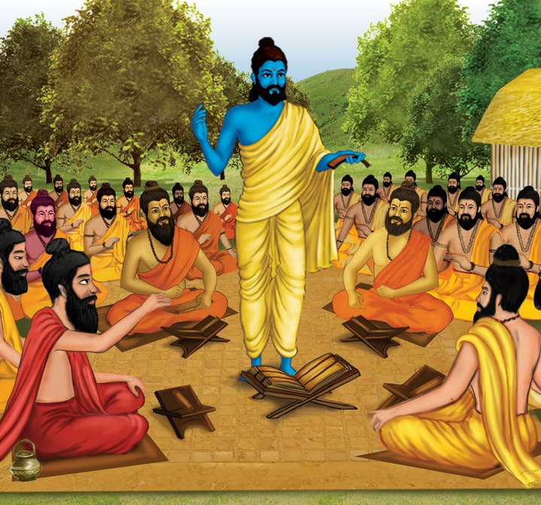
The Vedas are regarded as ”Shruti ” in Hinduism meaning “what is heard” as contrasted with other texts designated Smritis (“what is remembered”).
The laws of the veda's have regulated the social, legal, domestic, religious customs of Hindu's upto the present day.
Although the veda's are seldom read (or) understood today, even by the devout, they no doubt from the bedrock of the universal religion (or) " Sanathana Dharma " that all Hindu's follow.

Slide 5
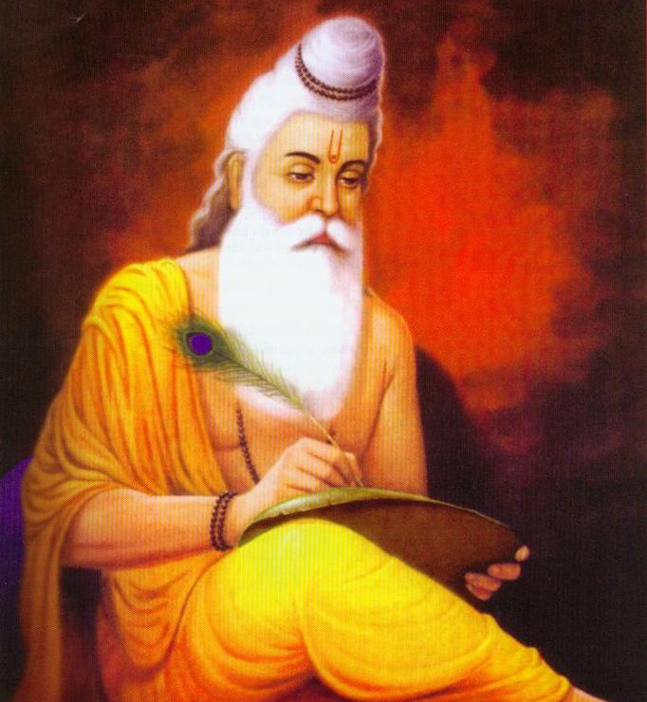
Who wrote Vedas ?
Tradition has it that humans did not compose the revered compositions of the Vedas, but that God taught the Vedic hymns to the sages, who then handed them down through generations by word of mouth.
Another tradition suggests that the hymns were "revealed," to the sages, who were known as the seers or “mantradrasta” of the hymns.
The formal documentation of Vedas was done mainly by Vyasa Krishna Dwaipayana around the time of Lord Krishna (c. 1500 BC)

Slide 6
Each Veda has been subclassified into four major text types or four portions :
The Samhitha's ( hymns ) : The most ancient layer of text in the Vedas, consisting of mantras, hymns, prayers, and benedictions which has in literary terms put together or joined the other three texts.
The Brahmanas ( rituals ) : They constitute the philosophy behind the ritual sacrifice.
The Aranyakas ( theologies ) : They form the philosophy behind the ritual sacrifices.
The Upanishads ( philosophies ) : They consist of conversations between teachers and students which clarify the philosophical message of the Vedas.

Slide 7
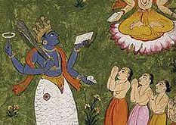
The Samhitas
Samhita literally means "put together, joined, union “a "collection", and "a methodically, rule-based combination of text or verses". Samhita also refers to the most ancient layer of text in the Vedas, consisting of mantras, hymns, prayers, litanies and benedictions.
Saṃhitā (संहिता) in the feminine form of the past participle, is used as a noun meaning "conjunction, connection, union", "combination of letters according to euphonic rules", or "any methodically arranged collection of texts or verses".
Samhita is a Sanskrit word from the prefix sam (सम्), 'together', and hita (हित), the past participle of the verbal root dha (धा) 'put'.The combination word thus means "put together, joined, compose, arrangement, place together, union", something that agrees or conforms to a principle such as dharma or in accordance with justice, and "connected with".

Slide 8
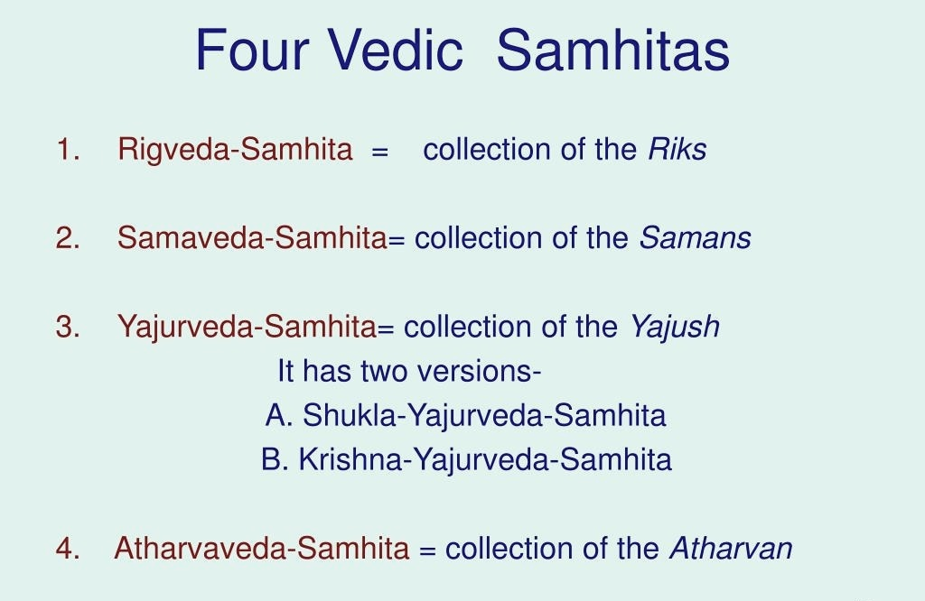
Classification of the Samhitas
The four Samhitas are:
Rig-Veda Samhita - the oldest veda, containing 1,028 hymns devoted to ancient gods.
Atharva-Veda Samhita - ancient spells and magical charms that pre-date the Aryan influence.
Yajur-Veda Samhita - a handbook for priests performing sacrifices.
Sama-Veda Samhita - chants and songs to sing during sacrifices.

Slide 9
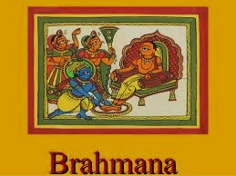
The Brahmanas
The Brahmanas (Sanskrit : ब्राह्मणम्, Brāhmaṇam) are Vedic śruti works attached to the Samhitas (hymns and mantras) of the Rig, Sama, Yajur, and Atharva Vedas.
The oldest Brahmana is dated to about 900 BCE, while the youngest are dated to around 700 BCE.
They are a secondary layer or classification of Sanskrit texts embedded within each Veda, often explain and instruct Brahmins on the performance of Vedic rituals (in which the related Samhitas are recited).
In addition to explaining the symbolism and meaning of the Samhitas, Brahmana literature also expounds scientific knowledge of the Vedic Period, including observational astronomy and, particularly in relation to altar construction, geometry.

Slide 10
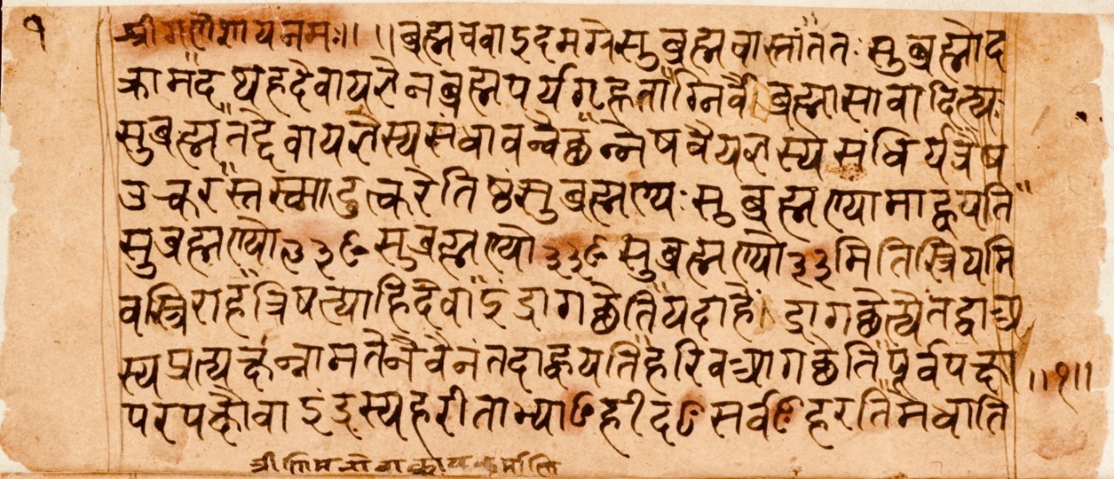
Brahmanas - Contents
Apastamba defines Brahmanas as ‘Karmacodana Brahmanani’ meaning Brahmanas are injunctions for the performance of sacrificial rites. According to him, these texts deal with the following six topics:Vidhi Arthavada , Ninda, Prashansha , Purakalpa and Parakriti.
Vidhi means injunctions for the performance of particular rites.
Arthavada comprises the numerous explanatory remarks on the meaning of Mantras and particular rites.
3. Ninda or censure consists in criticism and, refutation of
the opponents’ views.
4. Prashansha means eulogy, recommendation.
5. Purakalpa refers to the performance of sacrificial rites
in former times.
6. Parakriti means the achievements of others.

Slide 11
The main subject of the Brahmanas is injunction (Vidhi), all other topics being subservient to it. They may be classified differently. Shabara, in his commentary, has summed up their subjects into ten following heads:
Hetu – reasons
Nirvacana – etymology
Ninda – censure ,condemn
Prashansha – eulogy, praise
Sanshaya – doubt,uncertainty
Yajna is not only sacrifice. In Brahmanas we find it as symbolic also. Here it often represents the knowledge of creation and thus describes the secrets of creation.
Vidhi – injunction,sanction
Parakriya – feats/deeds of others
Purakalpa – legendary background
Vyavadharana– Kalpana – managerial application
Upamana – illustration

Slide 12
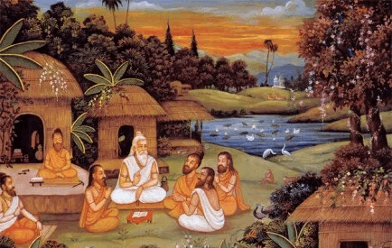
The Aranyakas
Aranyakas are generally the concluding portions of the several Brahmanas, but on account of their distinct character, contents and language deserve to be reckoned as a distinct category of literature.
Aranyakas describe the actions of life and also acquisition of knowledge. These works form the basis of the Rahasya or secrets discussed in the Upanishads, therefore, another name of the Aranyakas was ‘Rahasya‘ as well.
The term Aranyaka is derived from the word ‘Aranya‘ meaning ‘forest’. The Aranyaka texts are so-called because ‘they were works to be read in the forest’ in contradistinction to the regular Brahmanas. Sayana in the Taittiriya Aranyaka explains-
“ Aranyadhyayanad-etad –aranyakam-itiryate ”

Slide 13
Aranyakas - Contents
The major contents of the Aranyakas are theosophy (Brahmavidya), meditation (Upasana) and knowledge of breath (Pranavidya).
They describe the secret meaning of the sacrifice and the concept of Brahma as well.
The creation of the universe, the power of the Almighty, Om, the soul and the cycle of birth and death are explained in Brihadaranyaka in a simple manner.
No nation, no country, no culture in this age of science has been able to produce such great truths related to the knowledge of the Self and the Almighty as are mentioned in this Aranyaka.
Aranyakas play the role of the middle path and help to bridge the gulf between the Karma- kanda and Jnana-kanda.

Slide 14
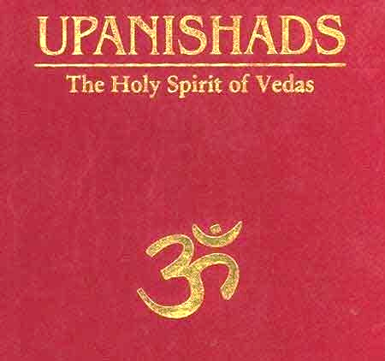
The Upanishads
The Vedas are generally considered to have two portions viz., Karma-Kanda (portion dealing with action or rituals) and Jnana-Kanda (portion dealing with knowledge). The Samhita and the Brahmanas represent mainly theKarma-Kanda or the ritual portion, while the Upanishads chiefly represent the Jnana-Kanda or the knowledge portion.
The word ‘ Upanishad ’ has been derived from the root Sad (to sit), to which are added two prefixes: Upa and Ni.
The prefix Upa denotes nearness and Ni totality. Thus, this word means ‘sitting near by devotedly’. This no doubt refers to the pupil’s sitting down near his teacher at the time of instruction.
The word in course of time gathered round it the sense of secret teaching or secret doctrine (Rahasya) which was imparted at such sittings. Upanishads are frequently spoken of as Rahasya (secret) or Guhya (mystery) also.

Slide 15
Importance of Upanishads
The Upanishads occupy a unique place in the development of Indian philosophical thought. They contain the highest authority on which the various systems of philosophy in India rest. So Vedanta Philosophy is directly related to the Upanishads.
The Upanishads are associated with the Vedas and make the entire range of Vedic knowledge as complete. ‘The Upanishads generally mention the Vedas and their study with respect. Certain verses from the Vedas, such as the Gayatri, form the subject of meditation here.
Each of the Vedas has many Mahavakyas or great sayings. But four Mahavakyas found in the Upanishads related to four Vedas are very important, thought-provoking and powerful.
Without understanding the Upanishads, it is impossible to get an insight into Indian history and culture.

Slide 16
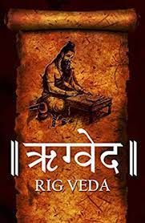
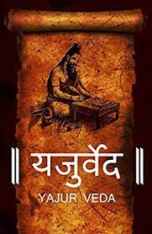
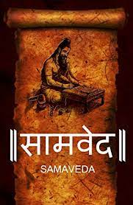
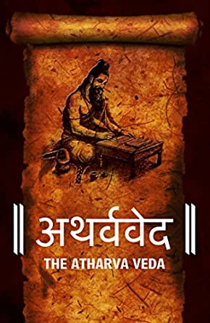
CHATURVEDA
There are four Vedas: Rig Veda, Yajur Veda, Sama Veda, and Atharva Veda, and all of them together are attributed to as ‘Chaturveda’. The Rig Veda serves as the principal one and all three but the Arthaveda agree with one another in form, language, and content.

Slide 17
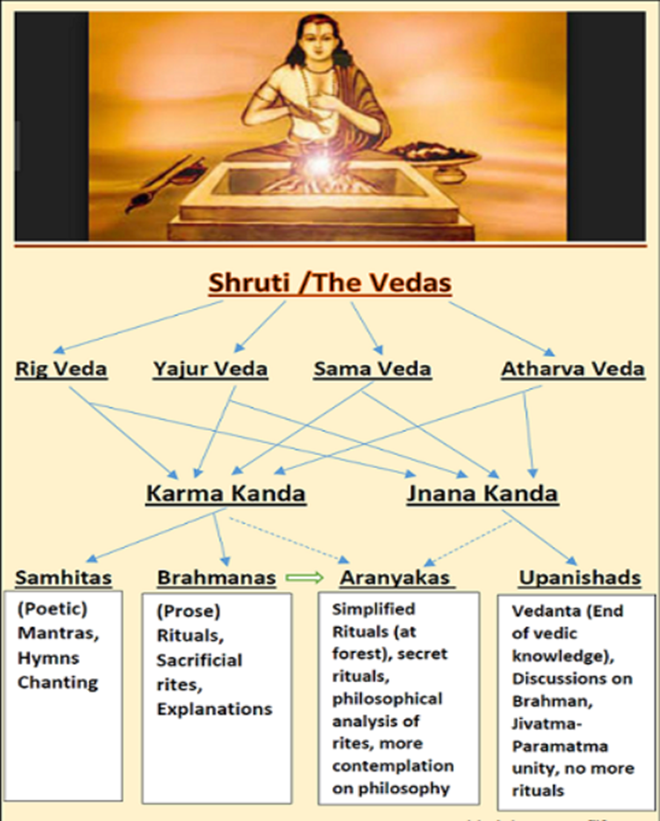
Classification of Vedas :
Rig-Veda "Knowledge of the Hymns of Praise“
Sama-Veda "Knowledge of the Melodies“
Yajur-Veda "Knowledge of the Sacrificial formulas“
Atharva-Veda "Knowledge of the Magic formulas”

Slide 18
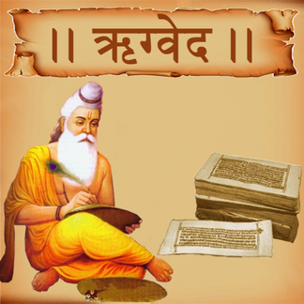
RIG VEDA

Slide 19
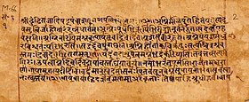
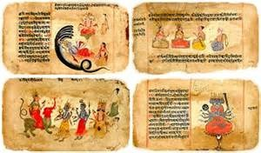
Rig Veda, one of the oldest texts of the Indo-Aryan Civilization still extant, is an ancient Indian collection of Vedic hymns.
Two Sanskrit words Rig and Veda constituting it translates to ‘praise or shine’ and ‘knowledge’ respectively.
A collection of 1,028 hymns in all, organized into ten different Mandalas (or the books; Sanskrit), it is the principal and oldest of the four Vedas.
The hymns are divided into eight 'ashtakas' (songs) each having eight 'adhyayas' (sections), which are sub-divided into various groups with a total of about 10,600 stanzas.
The earliest texts of the Rig Veda were composed in the greater Punjab (Northwest India and Pakistan), and the more philosophical later texts were composed in or around the region of Haryana (Modern-day State of India).

Slide 20
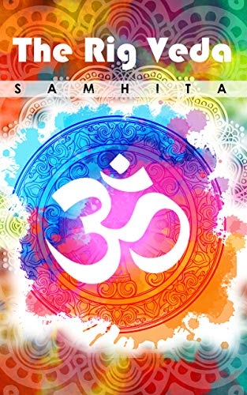
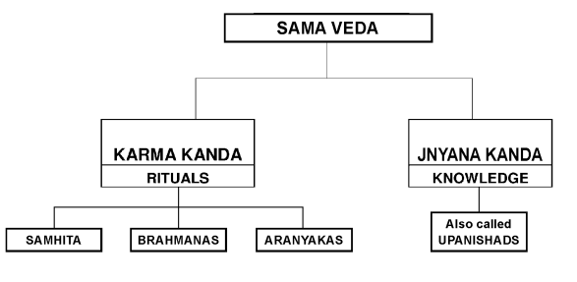
The Samhithas (Hymns)
The hymns are collection of the work of many authors called 'rishis' (according to post Vedic tradition "seers"). Atri, Kanwa,Vashistha, Vishwamitra, Jamadagni, Gotama and Bharadwaja are considered as the seven primary seers.
The hymns are devoted to thirty-three different gods, most of them nature gods like Indra (rain god), Agni (fire god), Rudra (storm god) etc. A sizeable chunk of the verses are also dedicated to Soma (air god).

Slide 21
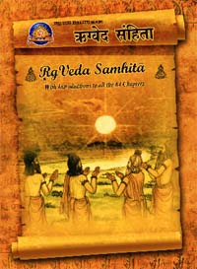
Among 1028 Suktas of the Rigveda Samhita some suktas are very popular and frequently referred by the readers of Vedas. Some of them are:
Purusha Sukta
Hiranya-garbha Sukta
Dhana-anna-dana Sukta
Aksha Sukta
Nasadiya Sukta
Duhsvapna-nashna Sukta
Yama-yami-samvada Sukta

Slide 22
The Brahmanas (Rituals )
The word ‘Brahmana’ has its root in the word ‘brahman’ which means ‘prayer’ or ‘devotion’. The word ‘brahman’ is distinct from the word ‘Brahman’ which means ‘the immanent Power’. The Brahmanas hint at ‘the magic’ or ‘the secret power’ of the sacrificial rituals.
Rig-Veda has two Brahmanas viz. Aitareya Brahmana & Kaushitaki Brahmana.
Aitareya Brahmana: Sometimes it is also known as Ashvalayana Brahmana. It is older than Kaushitaki in style and content. The legendary author ascribed for this Brahmana is Mahidas Aitareya. It is of Shakala shakhas of Rig-Veda
Kaushitaki Brahmana : It is of the Vatkal or Bashkala shakhas of Rig-Veda and sometimes also known as Śānkhāyana Brahmana. It is younger in content and style.

Slide 23
The Aranyakas
Aitareya Aranyaka belongs to the Shakala recension of the Rigveda and it is divided into five major segments, known as Aranyakas.
The first Aranyaka deals with Mahavrata, second Aranyaka about significance of the Ukthas and the Upanishadic text, third Aranyaka about spiritual meaning of various interpretation of the Samhitas including padapatha, kramapatha etc. for recitation of the Vedamantras along with the Svaras), fourth Aranyaka about collection of Mahanamni verses and the fifth Aranyaka deals about mystic Shastras.The Aranyaka signifies symbolic meaning of the Vedic sacrifices.
The Shankhayana Aranyaka belongs to Kaushitaki and Shankhayana recension of the Rigveda. The Aranyaka is considered as a Vedic text containing mystic and spiritual thoughts related to Vedic Philosophy and Ritualistic concept.

Slide 24
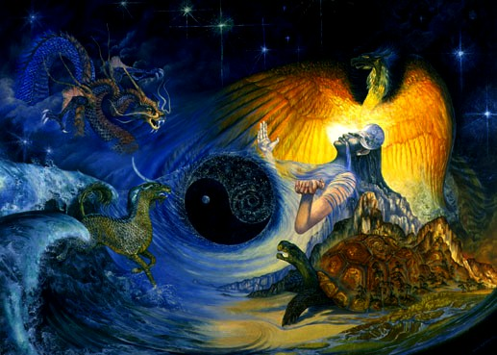
The Upanishads
The Aitareya Upanishad belongs to fourth, fifth and sixth chapters of the second book of AitareyaAranyaka of the Rigveda and considered as the oldest Upanishads. The Upanishad is divided into three chapters followed by thirty three verses.
The Aitareya Upanishad deals with philosophy of the Vedic religion, including soul, creation, birth and rebirth etc.

Slide 25
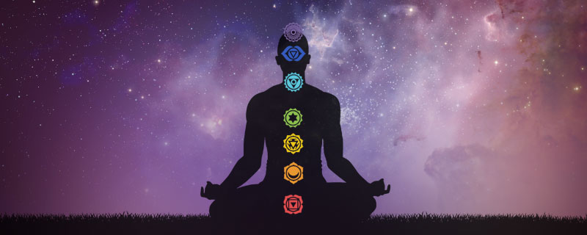


Slide 26
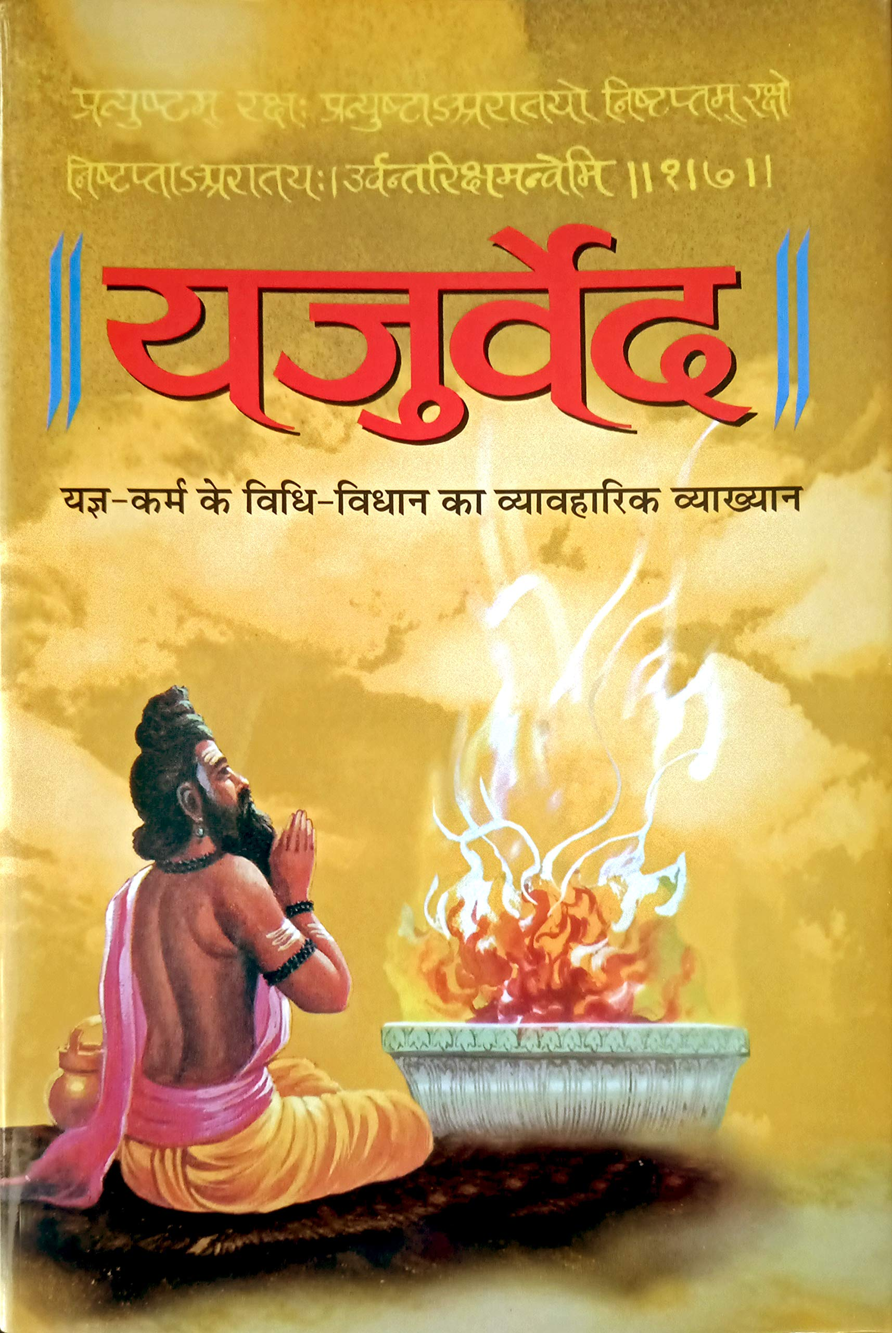
YAJUR VEDA

Slide 27
The Yajur Veda comprises of Yajus and Ved, meaning prose dedicated to reverence or religious worship.
Second of the four Vedas that emerged out of the southern face of Brahma.
The Yajur Veda served as a practical guidebook for the priests who execute sacrificial acts while muttering simultaneously the prose prayers and the sacrificial formulae (‘yajus’).
The core of the Veda is dedicated to the theory of the rituals thereby making it very much ritual based.
Most of the Yajur Veda goes back to 1200 to 1000 BCE and is contemporary to the hymns sung in the Sama Veda and Atharva Veda.
There are no less than six complete recessions of Yajur Veda--Madyandina, Kanva, Taittiriya, Kathaka, Maitrayani and Kapishthala.

Slide 28
The Samhithas
The Yajurveda is broadly grouped into Krishna Yajurveda and Shukla Yajurveda, also referred to as the Black Yajurveda and the latter as the White.
In reference to the verses of the Krishna Yajurveda being un-arranged, unclear, and disparate or dissimilar, the collection is too often referred to as Black Yajurveda.
In contrast, the well-arranged and imparting a particular meaning, the Shukla Yajurveda is known as the White Yajurveda.
Sukla Yajurveda has two Samhita available today:
Madhyandina Samhita
Kanva Samhtia
Krishna Yajurveda has four Sanhitas available today:
Taittiriya Samhita
Kathaka Samhita
Kapishthala Samhita
Maitrayani Samhita

Slide 29
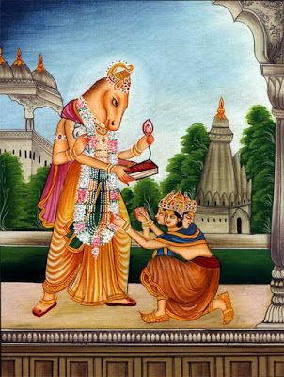
The Brahmanas
Brahmanas of Yajurveda :
Shukla Yajurveda
Shatapatha Brahmana (Madhyandina)
Shatapatha Brahmana (Kanva)
Krishna Yajurveda
Taittiriya Brhamana
Maitrayani Brahmana
Caraka-Kathaka Brahmana
Kapisthala-Katha Brahmana

Slide 30
The Aranyakas and Upanishads
Aranyakas of Yajurveda :
Brihadaranyaka (Madhyandina)
Brihadaranyaka (Kanva)
Upanishads of Yajurveda :
Shukla (White) Yajurveda
Ishavasyopanishad (Madhyandina)
Ishavasyopanishad (Kanva)
Brihadaranyakopanishad (Madhyandina)
Brihadaranyakopanishad (Kanva)
Krishna (Black) Yajurveda
Taittiriyopanishad
Shvetashvataropanishad
Maitrayaniopnishad
Kathakopanishad
Kathopanisad

Slide 31
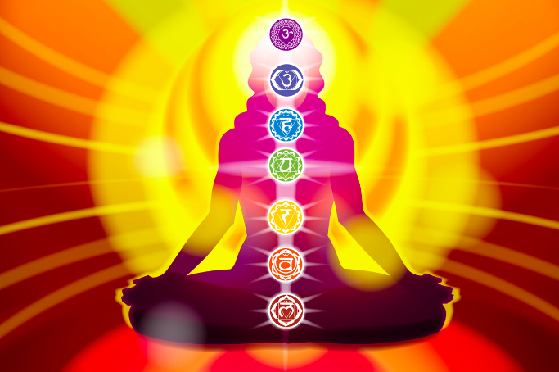

Slide 32
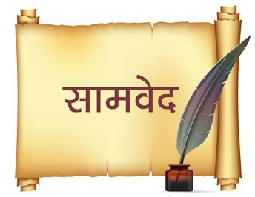
SAMA VEDA

Slide 33
The Sama Veda (“Melody Knowledge” or “Song Knowledge”) is a work of liturgical songs, chants, and texts meant to be sung.
The content is almost wholly derived from the Rig Veda mantras (riks) and, as some scholars have observed, the Rig Veda serves as the lyrics to the melodies of the Sama Veda.
It is comprised of 1,549 verses and divided into two sections: the gana (melodies) and the arcika (verses).
Samas are those mantras of Rig Veda which had been set to the tunes as prescribed by special treatises.
According to one calculation there are 1,875 Riks and 2,639 samas.
The melodies are thought to encourage dance which, combined with the words, elevates the soul.
Sama Veda has around thousand shakas (branches) of which only 13 are discovered so far. These 13 are the names of the teachers who are responsible for their recension.
Three of those shakas are extant now. They are Jaiminyasakha, Kauthumasakha, and Ranayaniyasakha.

Slide 34
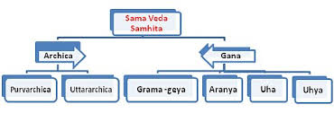
The Samhithas
Samaveda samhitha is not meant to be read as a text, it is like a musical score sheet that must be heard.
A vast majority of Sama Veda Samhita has been dedicated to the praise of Agni, Indra, and Soma.
The veda also contains a Brahmana, which describes the necessary procedures that are to be followed before as well as during the chanting of the Samaveda Samhita.
It sets the standards for the proper recitation of the Samhita. It also contains topics centering on social customs as well as countering bad omens.

Slide 35
The Brahmanas
Brahmanas of Samveda :
Samveda has following 10 Brahmanas
Jayminiya Brahmana
Tandyamaha or Pancavimsa Brahmana
Sadvimsa Brahmana
Samavidhana Brahmana
Arseya Brahmana
Devatadhyaya or Daivata Brahmana
Mantra or Chandogya Brahmana
Samhitopanisad Brahmana
Vamsa Brahmana
Jayminiya Arseya Brahmana

Slide 36
The Aranyakas and Upanishads
Aranyakas :
There is only one Aranyaka available called Talvakara Aranyaka, it is part of Talvakara Brahmana.
Upanishads :
Chandogya and Kena (or Talvakara) Upanishads are the major Upanishads of Sama Veda
Other minor Upanishads of Sama Veda include Arunopanishad; Jabaladarsanopanishad; Jabalyupanishad; Mahopanishad; and Vasudevaopanishad

Slide 37
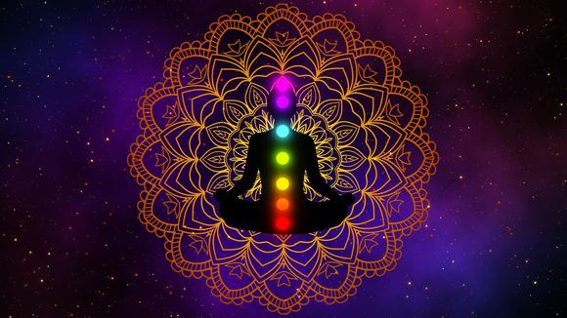

Slide 38
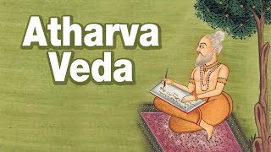
ATHARVA VEDA

Slide 39
The Atharva Veda (“knowledge of Atharvan”) differs significantly from the first three in that it concerns itself with magical spells to ward off evil spirits or danger, chants, hymns, prayers, initiation rituals, marriage and funeral ceremonies, and observations on daily life.
It is comprised of 20 books of 730 hymns, containing 6000 mantras some of which draw on the Rig Veda.
The Atharva Veda still finds its relevance in today’s contemporary society as it has been a pioneer in influencing modern medicine and healthcare, culture and religious celebrations, and even literary tradition in the Indian sub-continent as it contains the oldest known mention of the Indic literary genre.

Slide 40
The Samhithas
The Samhitas in the Atharva Veda have written accounts of Surgical and medical speculations, it includes mantras and verses for treating a variety of ailments.
The Atharva-Samhita contains mantras meant for routine rites and rituals.
Numerous hymns of the Atharvaveda are prayers and incantations wishing a child or loved one to get over some sickness and become healthy again, along with comforting the family members.
According to Patanjali, Atharvaveda had nine Shakhas, but the Samhita of the Atharvaveda is today available only in two rescensions – the Shaunaka and the Paippalada.
It is the Shaunaka-Samhita that is frequently meant when the Atharvaveda is mentioned in ancient and modern literature. It is a collection of 730 hymns containing 5987 Mantras, divided into 20 books (Kandas).

Slide 41
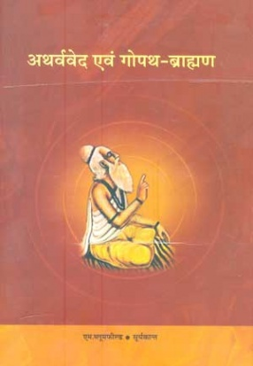
The Brahmanas
Atharva Veda has only one Brahmana and that is Gopatha Brahmana.
The Gopatha Brahmana is associated with the Atharvaveda and dividd into two khandas (chapters), i.e. Purvabhaga and Uttarabhaga. The Purvabhaga is divided into 5 prapathakas and 135 kandikas and the Uttarabhaga is divided into 6 prapathakas and 123 kandikas.
The Gopatha Brahmana differs from other vedic texts, such as in its concept of creation of universe, concept of om, view on Gayatri and Brahmacharya, interpretation of sacrifice, priests, liturgical formalities; and classification of sacrifices, as well as grammatical and linguistic peculiarities.

Slide 42
The Aranyakas and Upanishads
No Aranynaka of Atharva Veda has come to light to date.
The Atharvaveda has three primary Upanishads embedded within it.
Mundaka Upanishad
It is a poetic-style Upanishad, with 64 verses, written in the form of mantras. However, these mantras are not used in rituals, rather they are used for teaching and meditation on spiritual knowledge.
Mandukya Upanishad
The Mandukya Upanishad is the shortest of all the Upanishads, found in the Atharvaveda text. The text discusses the syllable Om, presents the theory of four states of consciousness, asserts the existence and nature of Atman (Soul, Self).
Prashna Upanishad
The Prashna Upanishad is from the Paippalada school of Atharvavedins.
The text contains six Prashna (questions), and each is a chapter with a discussion of answers.

Slide 43
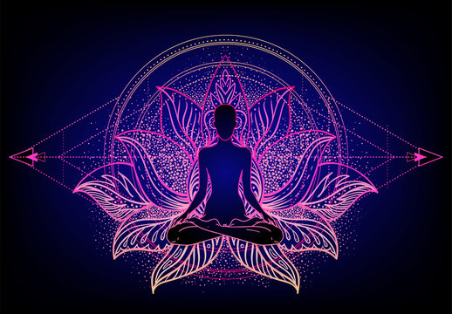

Slide 44
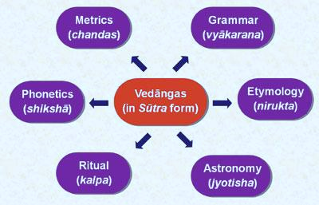
The Vedangas
The Vedanga ( "limbs of the Veda“ ) are six auxiliary disciplines of Hinduism that developed in ancient times, and have been connected with the study of the Vedas.
The Vedangas are the last treatises of the Vedic Literature.

Slide 45
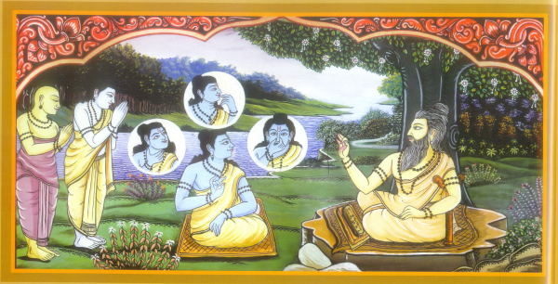
SHIKSHA ( Phonetics )
Shiksha really means instruction: then in particular ‘ instruction in reciting ’ i.e., in correct pronunciation, accentuation etc. of the Samhita texts.
Later, it was a name given to works containing rules regarding the proper pronunciation of Vedic texts. Thus, the Shiksha-Sutras are treatises on phonetics.
Phonetics is most important in the case of the Vedic
language.
Some important Pratishakhyas are:
Rigveda-Pratishakhya of Rigved
Taittiriya-Pratishakhya of Krishna Yajurveda
Vajasaneyi Pratishakhya of Shukla Yajurveda
Atharvaveda-Pratishakhya of Atharvaveda

Slide 46
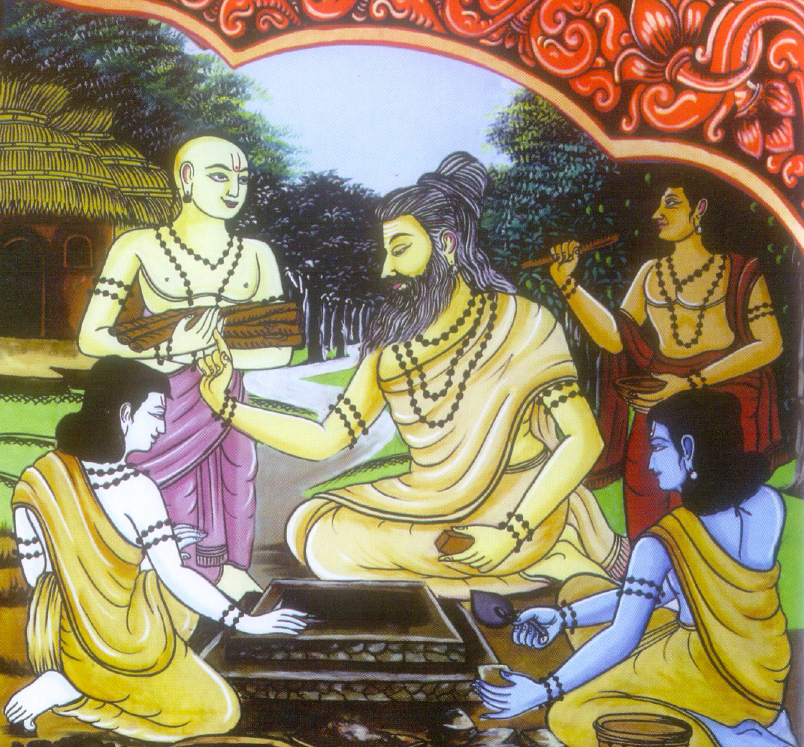
KALPA ( Rituals )
The second Vedanga is Kalpa (ritual) which is called the arms of the Veda Purusha. It is especially intended for the proper application of the Vedic texts.
The oldest Kalpasutras are those which in their contents are directly connected with the Brahmanas and Aranyakas.
It was the ritual (Kalpa), the chief contents of the Brahmanas, which
first received systematic treatment in the manuals called the Kalpasutras.
There are four types of the Kalpasutras:
Shrauta-sutras, dealing with Shrauta sacrifices
Grihya-sutras, dealing with the domestic ceremonies
Dharma-sutras, dealing with the religious and social laws
Shulba-sutras, dealing with the rules of measurement of the fire-altars etc.

Slide 47
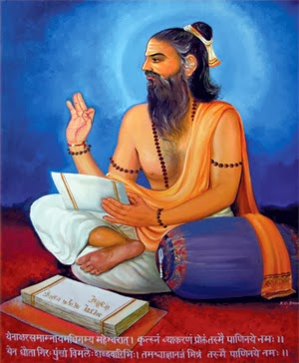
VYAKARANA ( Grammar )
The third Vedanga is Vyakarana or grammar, which is necessary for the understanding of the Veda. It is called the mouth of the Veda Purusha.
The old Vedanga-texts on Vyakarana are entirely lost today. In the Aranyakas, we find some technical terms of grammar.
The only representative of this Vedanga is the Ashtadhyayi of Panini, which belongs to a later period. It is indeed the most celebrated text-book of grammar.
Formation of the word is the main subject of grammar. It discusses root (Prakriti) and suffix (Pratyaya) of a word to study its meaning. Panini’s Vyakarana is in the form of sutras or aphorisms.
The fourteen Sutras are referred to here, as Maheswara Sutras. They were originated from Nataraja’s damuru sound.

Slide 48
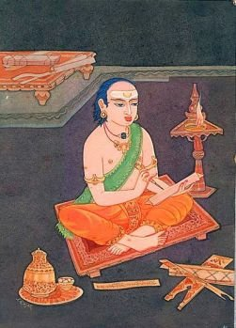
NIRUKTA ( Etymology )
Nirukta Vedanga is called the ears of the Veda Purusha.
‘Nirukta’ means ‘etymology’ and it explains the reason why a particular word has been used i.e., the meaning of usage.
The only work which has survived as a specimen of this Vedanga ‘etymology’ is the Nirukta of Yaska.
It is a commentary on Nighantu which is ‘list of words’ found in the Vedas. Tradition ascribes the Nighantu also to Yaska.
The Nighantus are five lists of words, which are again divided into three sections.

Slide 49
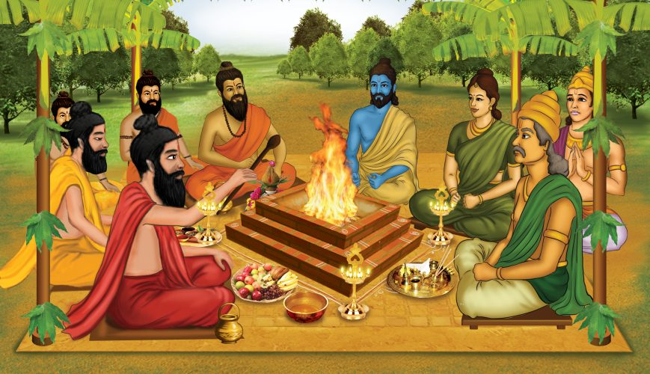
CHANDAS ( Metrics )
Chandas Vedanga is regarded as the feet of the Veda Purusha. The body of the Vedas rests on the Chandas which are in the nature of feet.
Each Mantra of the Veda has a special Chandas, just as it has a presiding Devata.
According to Nirukta the term Chandas is derived from the root Chad (to cover). Meter is called Chandas because it covers the sense of the Mantra.
The texts, dealing with Vedic meters, are as follows:
Rikpratishakhya
Shankhayana Shrauta-sutra
Nidana-sutra of Samaveda
Chandas-sutras of Pingala

Slide 50
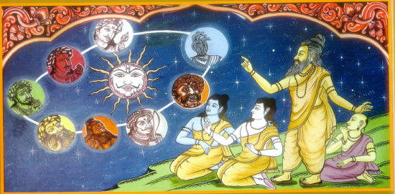
JYOTHISHA ( Astrology )
The last Vedanga Jyotisha is called eye – the organ of sight, of the Veda Purusha.
The object of Jyotisha Vedanga is not to teach astronomy, but to convey such knowledge of the heavenly bodies as is necessary for fixing the days and hours of the Vedic sacrifices. It gives some rules for calculating and fixing time for sacrifices.
It is unfortunate that there is no work available at present dealing with ancient Vedic astronomy (Jyotisha) in the Sutra style.
Only we have a small text-book called Jyotisha of Vedic astronomy in verses in two recessions.
Generally, Maharshi Lagadha is regarded author of this Vedanga Jyotisha.

Slide 51
CONCLUSION
The seven main concepts of Vedic Indian culture are:
One, all‐pervasive Supreme Being who may be worshipped through any form.
Dharma, that which sustains the universe: an all‐encompassing term representing divine law, path of righteousness, duty, responsibility, virtue, justice, goodness and truth.
The Universe undergoes endless cycles of creation, preservation and dissolution.
Karma, the law of cause and effect by which each individual creates his own destiny by his thoughts, words and deeds.
The soul reincarnates, evolving through many births until the peace and bliss of moksha is attained through knowledge of the Absolute Reality.
The belief that no religion teaches the only way to salvation above all others, but that all genuine paths are facets of God’s Light, deserving tolerance and understanding.
An enlightened master, or Satguru, who is essential for gaining knowledge of the Absolute Reality.

Slide 52
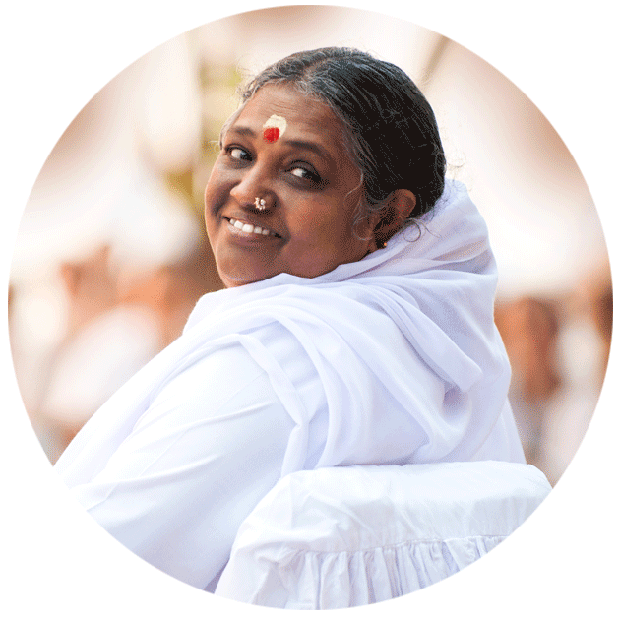
WORDS BY AMMA
As Amma says, “ One Truth shines through all of creation ; rivers, mountains, plants and animals, the sun, the moon, and all the stars , you and I all are expressions of this one Reality. When you behold everything as God, your whole life becomes an act of worship, a form of prayer, a song of praise .“

Slide 53
THANK YOU

